Slide 1
Traffic Sign Recognition Using Co-Training
Spencer Riggins, Yiting Liu, Yajie Yang, Zhaolin Zhang

Slide 2
Introduction
Traffic-sign recognition is a technology by which a vehicle is able to recognize the traffic signs put on the road e.g. “speed limit” or “turn ahead”.
The topic we choose is part of the features collectively called Advanced driver-assistance systems.
We will use image preprocessing techniques to process the images first and then use different models to train and predict traffic signs.
Notes:
Vicky

Slide 3



What makes traffic sign recognition hard?
Poor Lighting
Obstruction
Motion Blur
Notes:
Carmen

Slide 4

Purpose
Develop a traffic-sign classification technique that is:
Accurate
Transferable to Different Countries
Requires Only a Small Amount of Labeled Data for Each Country
Notes:
Spencer

Slide 5
Data Sets
German Traffic Sign Dataset
39,209 color images that are used for training, and 12,630 images that we will use for testing.
Each image is a photo of a traffic sign belonging to one of 43 classes
Italy Traffic Sign Dataset
7,474 images for training, and 1,159 images use for testing
59 classes
Belgium Traffic Sign Dataset
4,575 images for training, and 2,520 images use for testing
62 classes
Data source: http://benchmark.ini.rub.de/?section=gtsrb&subsection=dataset#Downloads (German)
http://users.diag.uniroma1.it/bloisi/ds/dits.html (Italy)
https://btsd.ethz.ch/shareddata/ (Belgium)
Notes:
Jack
3- Classes
#Traffic Controls and Traffic Priority -> 0
#Speed Limit and Environmental Factors -> 1
#Vehicle Information and Pedestrian Signs -> 2

Slide 6
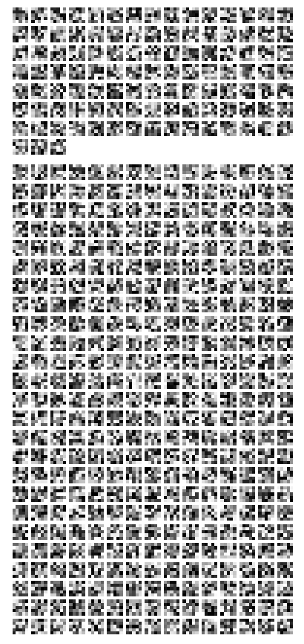
Preprocessing
Crop the ROI
Resize all images to 48x48
Turn to grayscale
According to Sermanet and Yann, using color channels didn’t help a lot in improving accuracy (2011) in CNN
Smooth by Gaussian filter
Histogram Equalization
Adaptive Histogram Equalization
Normalize
Notes:
Jack

Slide 7



Preprocessing
Notes:
Jack

Slide 8
Classifiers
Notes:
Jack

Slide 9
3 different classifiers
Convolutional Neural Network
Eigen-Face Algorithm
Co-Training Algorithm (based on above two classifiers)
Notes:
Jack

Slide 10
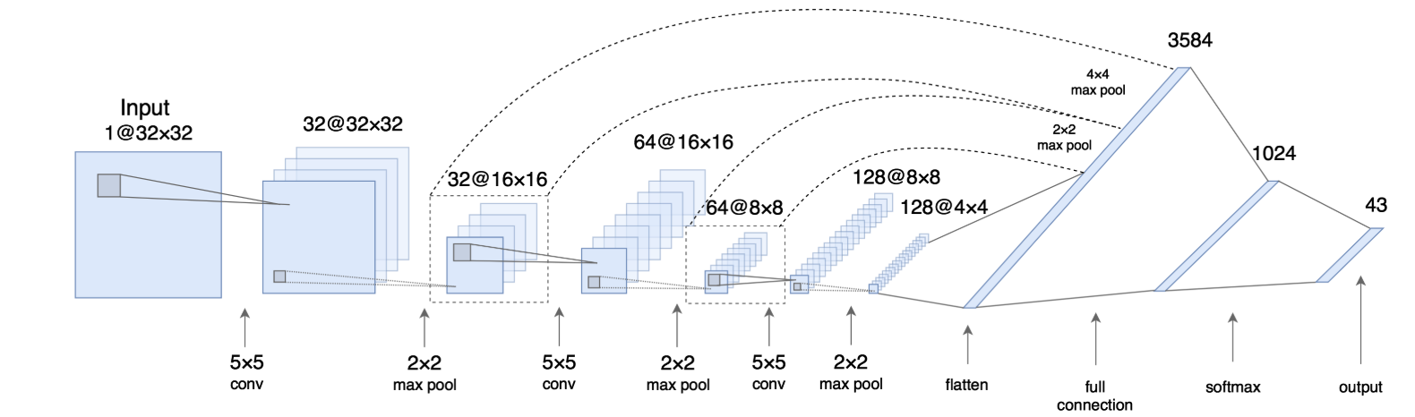
Convolutional Neural Network
Convolutional Networks (ConvNets), a biologically-inspired, multilayer feed-forward architecture that can learn multiple stages of invariant features using a combination of supervised and unsupervised learning
Notes:
Jack

Slide 11
Convolutional Neural Network
Layer | Type | # Maps & neurons
0 | Input | 1 map of 48 x 48 neurons
1 | Convolutional | 16 maps of 48 x 48 neurons
2 | Max Pool | 16 maps of 24 x 24 neurons
3 | Convolutional | 32 maps of 24 x 24 neurons
4 | Max Pool | 32 maps of 12 x 12 neurons
5 | Convolutional | 64 maps of 12 x 12 neurons
6 | Max Pool | 64 maps of 6 x 6 neurons
7 | Fully Connect | 128 neurons
8 | Fully Connect | # of output class
Notes:
Jack

Slide 12
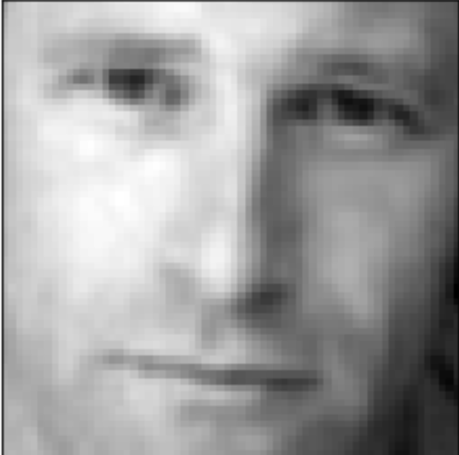
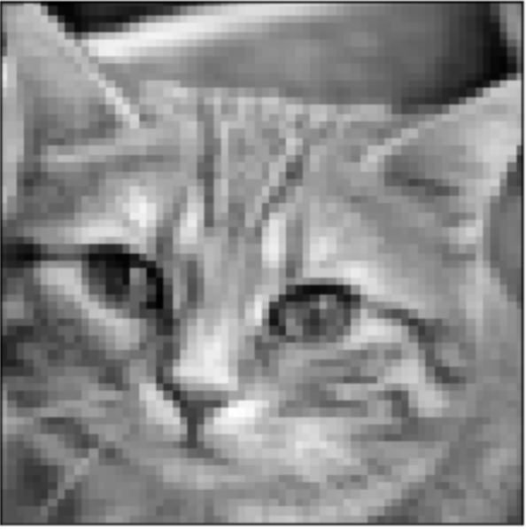

Eigen-Face Algorithm
Eigen-Face is a classic and widely used algorithm for face recognition. And its theoretical basis is the PCA (Principal Component Analysis), which is one of the most commonly used unsupervised learning algorithm to compress, extract features for data and even for dimensionality reduction purposes.
Basically, we did the following steps in our algorithm:
Dimensionality Reduction
Principal Component Analysis
Apply PCA transformation
Notes:
Carmen

Slide 13
Co-Training Algorithm
Uses two classifiers in conjunction
One CNN
One Eigen-Face
Trains both models using the same input data
Generates two sets of predictions from test data
Final prediction for each sample is normalized products of each classifier’s predicted class probabilities
Notes:
Spencer

Slide 14
Experimental Setup
Notes:
Spencer

Slide 15

Experimental Setup
Start with small amount of training data labeled for each country (20%), leaving the rest (80%) unlabeled
Train on the current labeled data, and then allow the classifier to predict class labels for the remaining unlabeled data
Apply predicted labels to 2000 most confidently predicted samples and add them to training set
Co-Train Algorithm allows each classifier to select 1000 samples
Accuracy on test set logged at the end of each iteration
Notes:
Spencer

Slide 16
Experimental Setup Cont.
Sample out 20% of training data as labeled data from both countries’ datasets (Germany and Italy)
Perform method from previous slide on German traffic sign data until all data labeled
Use pre-trained classifier to then perform method from previous slide on Italian traffic sign data
Notes:
Spencer

Slide 17
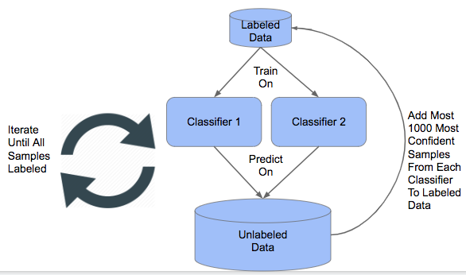
Experimental Visualization
Notes:
Spencer

Slide 18
Sample Codes
Notes:
Vicky

Slide 19
#Class that holds co-training classifier
class cotraining_object:
#Holds two different model objects
def __init__(self, modelA, modelB):
self.modelA = modelA
self.modelB = modelB
def train_models(self, data, labels):
self.modelA.train_model(data, labels)
self.modelB.train_model(data, labels)
return
#Return predictions from both sub-classifiers
def get_cotraining_predictions(self, data):
return self.modelA.get_predictions(data), self.modelB.get_predictions(data)
#Return actual co-training predictions (Product of sub-classifier predictions)
def get_final_cotraining_predictions(self, data):
return np.multiply(self.modelA.get_predictions(data), self.modelB.get_predictions(data))
#Untrain model (Not used)
def reset_models(self):
self.modelA.reset_model()
self.modelB.reset_model()
Notes:
Vicky

Slide 20
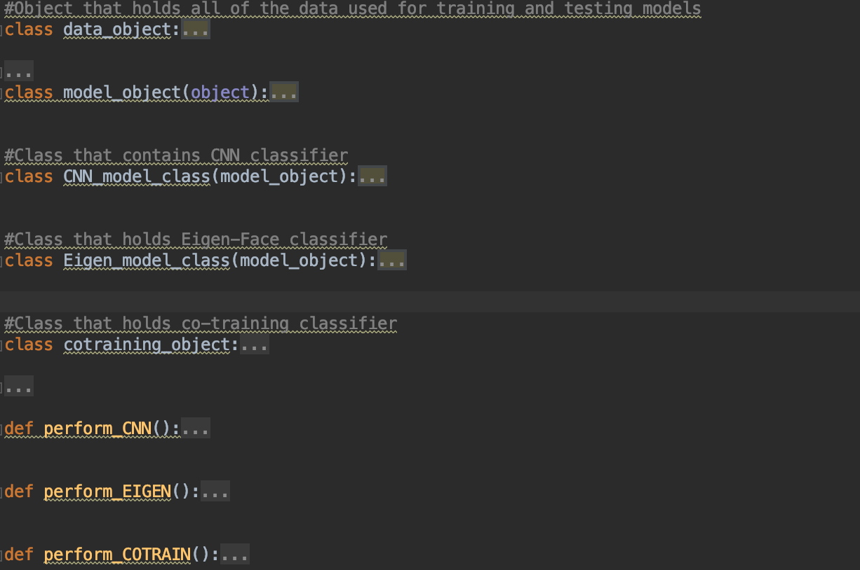
Notes:
Vicky

Slide 21
Results

Slide 22
Previous Results
Our Results
Classifier | Real Samples
DE: PC | 0.98
DE: SVR | 0.99
DE: PC & SVR | 0.99
IT: PC | 0.93
IT: SVR | 0.94
IT: PC & SVR | 0.94
Classifier | Real Samples
Germany: CNN | 0.988
Germany: Eigen Algorithm | 0.95
Germany: Co-Training Algorithm | 0.98
Italy: CNN | 0.90
Italy: Eigen Algorithm | 0.72
Italy: Co-Training Algorithm | 0.70
Hillebrand M., Kreßel U., Wöhler C., Kummert F. (2012) Traffic Sign Classifier Adaption by Semi-supervised Co-training. In: Mana N., Schwenker F., Trentin E. (eds) Artificial Neural Networks in Pattern Recognition. ANNPR 2012. Lecture Notes in Computer Science, vol 7477. Springer, Berlin, Heidelber
Notes:
Vicky

Slide 23
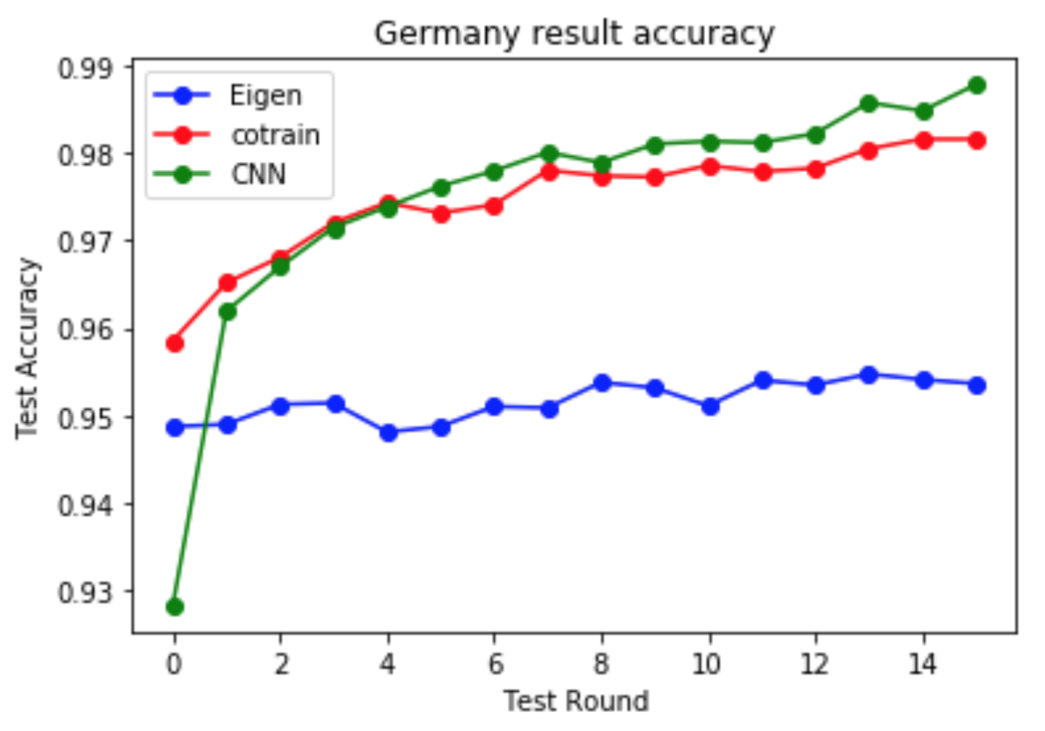
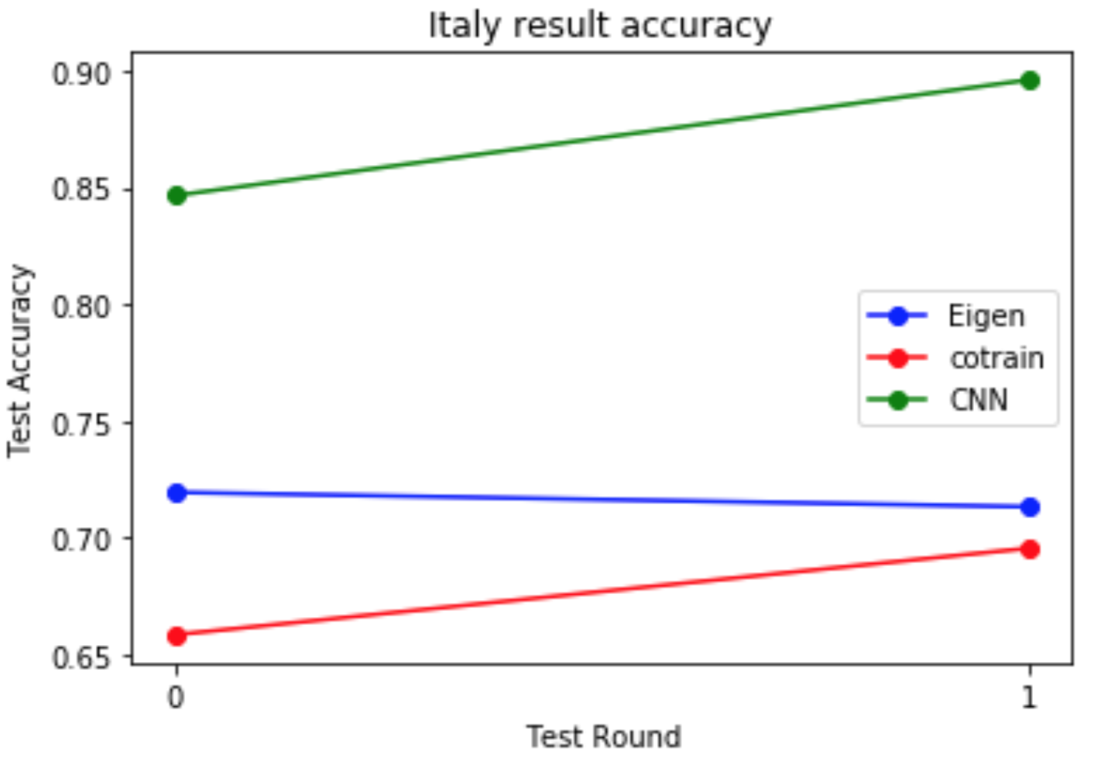
Our Results
Two images show accuracy result of two countries test data sets after each round.
Notes:
Vicky

Slide 24
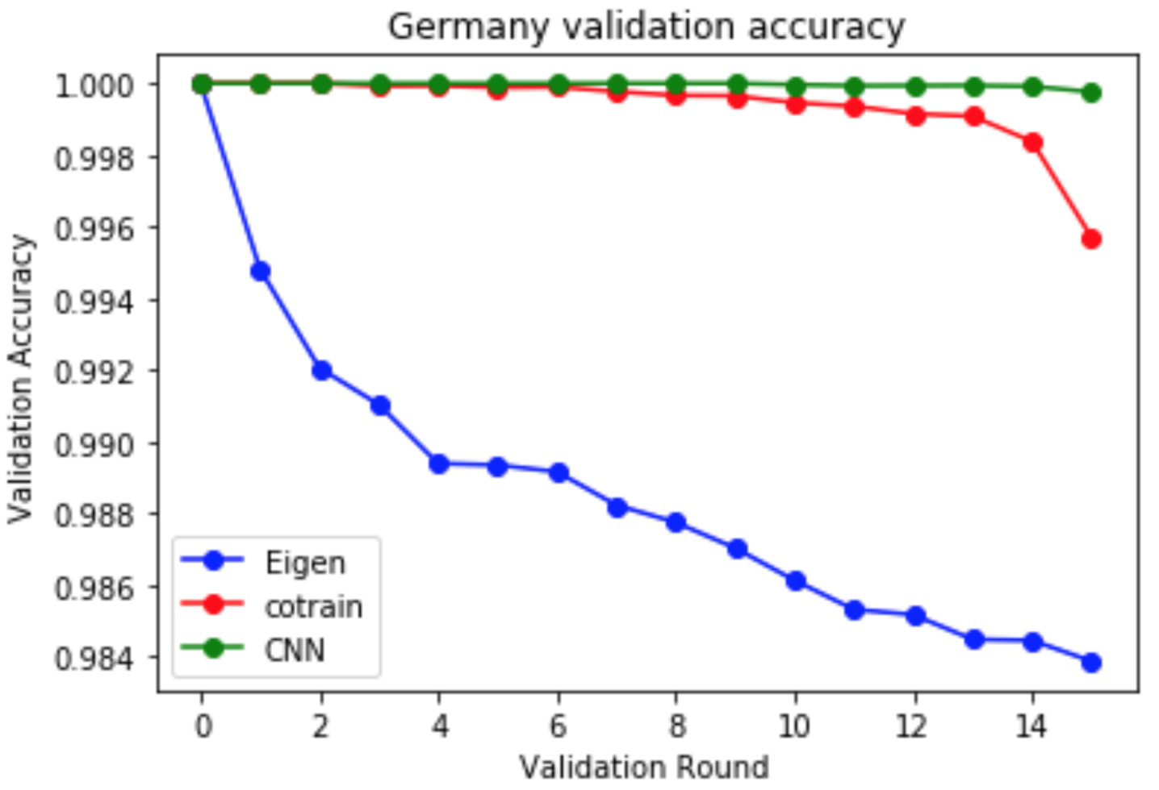
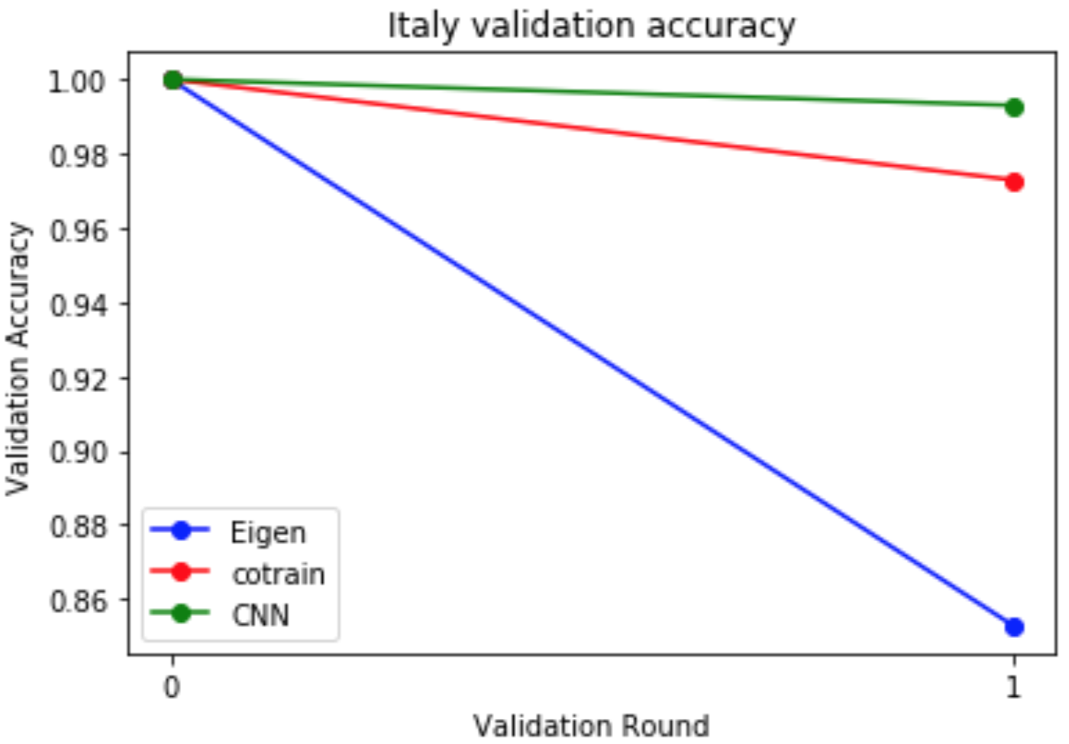
Our result
The images above show the percent of training data that is labeled correctly at each round.
Notes:
Spencer

Slide 25
Conclusions
It has been shown that a reasonably good classifier can be obtained by learning on only a small amount of labeled traffic sign data
It was also shown that our classifier can extend reasonably well to datasets obtained from other countries
Signs from other country must correspond well to signs from original country
Co-training can automatically learn unlabeled knowledge (unknown knowledge) and the accuracy doesn’t drop significant
Notes:
Jack

Slide 26
Conclusions
Co-training would significantly improve the test accuracy if both classifiers are weak classifiers. If there is one weak classifier and one strong classifier, Co-training will perform around the middle.
Notes:
Carmen

Slide 27
Improvement
Add different weights to the different classifiers may give better result than just half-half choice.
Pick multiple different feature based classifiers such as color-based and shape-based, so that co-training can take advantages of both and make better predictions.
Notes:
Carmen

Slide 28
Application and the Future

Slide 29
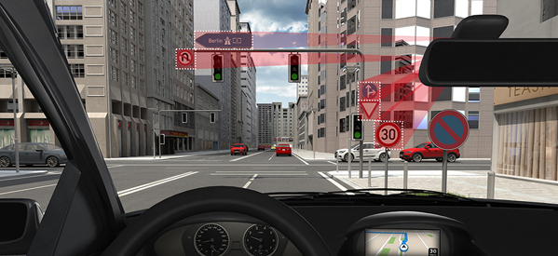
Real-time traffic sign detection based on the camera scene from a car:
Fast preprocessing of the road and sign image.
Extract useful road lines and sign region and use model to predict.
The car could make decision on the current prediction.
The next sign process may use the previous prediction and road situation as part of input.
Notes:
Spencer

Slide 30
References

Slide 31
Reference
“BelgiumTS Dataset” KUL Belgium Traffic Signs dataset, btsd.ethz.ch, 2014,
https://btsd.ethz.ch/shareddata/
“DITS - Data set of Italian Traffic Signs” Sapienza Università di Roma, December 2018,
http://users.diag.uniroma1.it/bloisi/ds/dits.html
“GTSRB - German Traffic Sign Recognition Benchmark.” Kaggle, kaggle.com, December 2018,
https://www.kaggle.com/meowmeowmeowmeowmeow/gtsrb-german-traffic-sign
Sermanet, Pierre, and Yann LeCun. "Traffic sign recognition with multi-scale Convolutional
Networks." IJCNN. 2011.
Hillebrand M., Kreßel U., Wöhler C., Kummert F. (2012) Traffic Sign Classifier Adaption by
Semi-supervised Co-training. In: Mana N., Schwenker F., Trentin E. (eds) Artificial Neural Networks in Pattern Recognition. ANNPR 2012. Lecture Notes in Computer Science, vol 7477. Springer, Berlin, Heidelber

